Slide 1

agile Sprint

Slide 2
What is an Agile Sprint
The ceremonies of an Agile Sprint
Objectives
To Understand

Slide 3
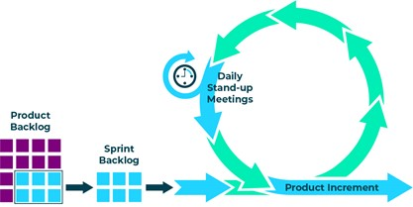
Sprint
A sprint is a time-boxed event in which work takes place.
Notes:
The scrum team along with the Product owner, have a meeting where they decide which items from the product backlog will be included in the next sprint.
This items are moved to the sprint backlog. The scrum team then work on the items until a product item is complete and will be able to be included in the next product increment. Each day first thing in the morning a Daily Stand-up meeting is held.

Slide 4
This meeting is held at the beginning of the sprint.
The meeting will usually take the full day for a two-week sprint and is split into two sections (what and how).
The first half of the meeting is where the team decide what is going to be brought into the sprint backlog.
The second half of the meeting is where the team decide how the items are going to be completed,
usually done by breaking down the tasks into smaller pieces and adding technical details.
Sprint planning
meeting

Slide 5

This is a daily 15-minute meeting used to optimise communication across the team.
Following points are discussed by every participant:
What did I do yesterday that helped meet the sprint goal?
What will I do today to help meet the sprint goal?
Do I see any future impediments that prevents the team from meeting the sprint goal?
Daily Stand up
Notes:
Each participant stands up when it is their turn to speak. This communication keeps the whole team up to date on progress. It also allows them to look at future impediments which need to be addressed to allow the team to meet their goals.
It is the responsibility of the Scrum Master to facilitate the removal of the impediments.

Slide 6
Held at the end of the sprint to inspect the work done and adapt the product backlog. The development team, product owner and key stakeholders are all present at this meeting. In the sprint review meeting:
The development team demonstrates what work was done, and answers any questions
The product owner discusses the product backlog as it stands
The entire group collaborates on what to do next, to provide valuable input to future sprint planning
Sprint Review
Meeting

Slide 7
The sprint retrospective meeting is an opportunity for the scrum team to inspect itself and create a plan for improvements to be made during the next sprint. The goal of the retrospective is to:
Inspect how the last sprint went with regards to people, relationships, process, and tools
Identify what went well and any potential improvements that could be made
Create a plan for implementing improvements to the way the scrum team works
Sprint retrospective meeting

Slide 8

You now can
describe what is an Agile Sprint
Explain what the ceremonies of an Agile Sprint are
Review

Slide 9
Complete Lab3
Duration 20 minutes
Lab

